Slide 1
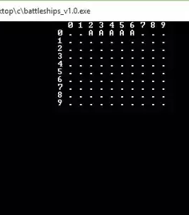
BATTLESHIP GAME
PRESENTED BY:
Jad Al Jourdi
Imad Chaar
Stephanie Chinenye Okosa
Maxim Emile Spezcyk
06.07.2021

Slide 2
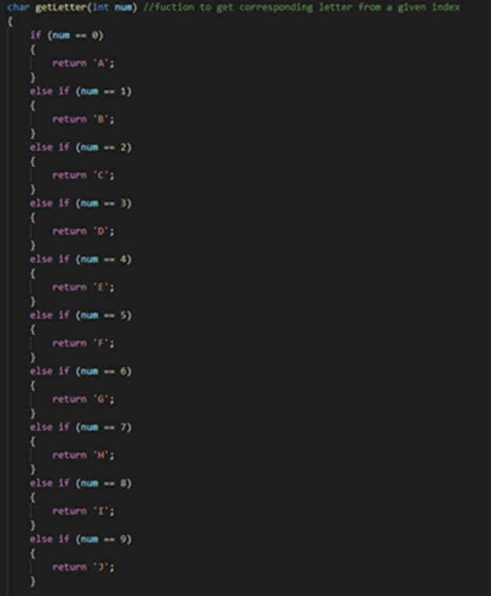
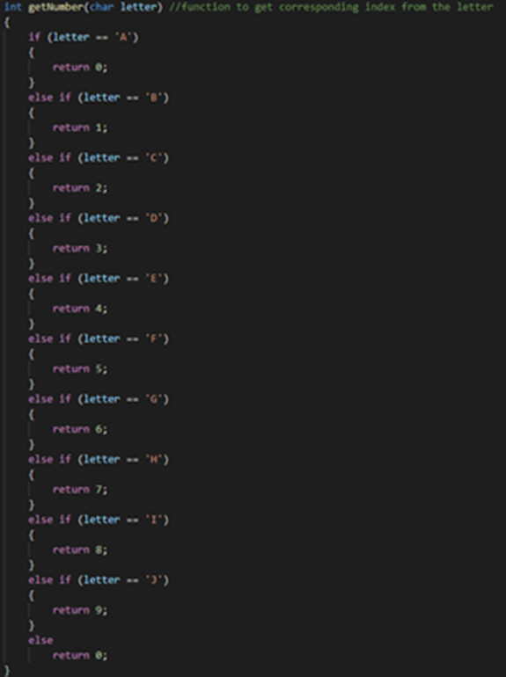
DEFINITION
Battleship is a two-player game whose goal is to hit and sink all the ships in the enemy's matrix, where the first player who sinks all 10 of the enemy's ships wins.

Slide 3
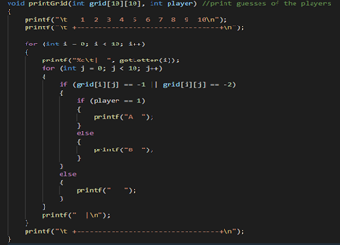
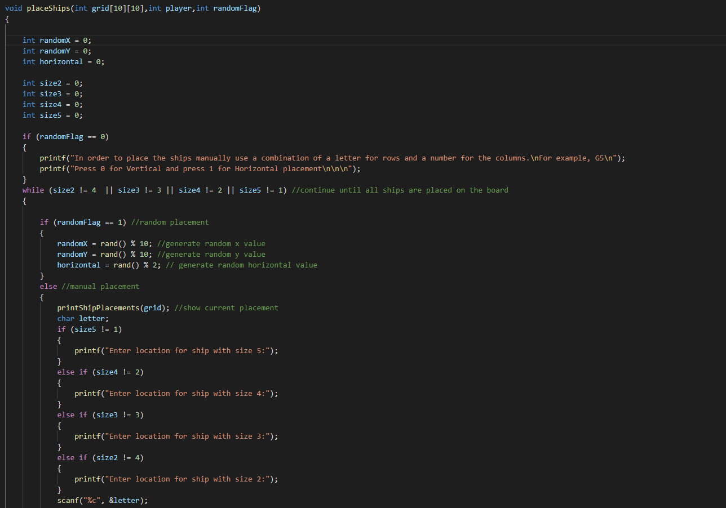
PrintGrid and PrintShips function

Slide 4
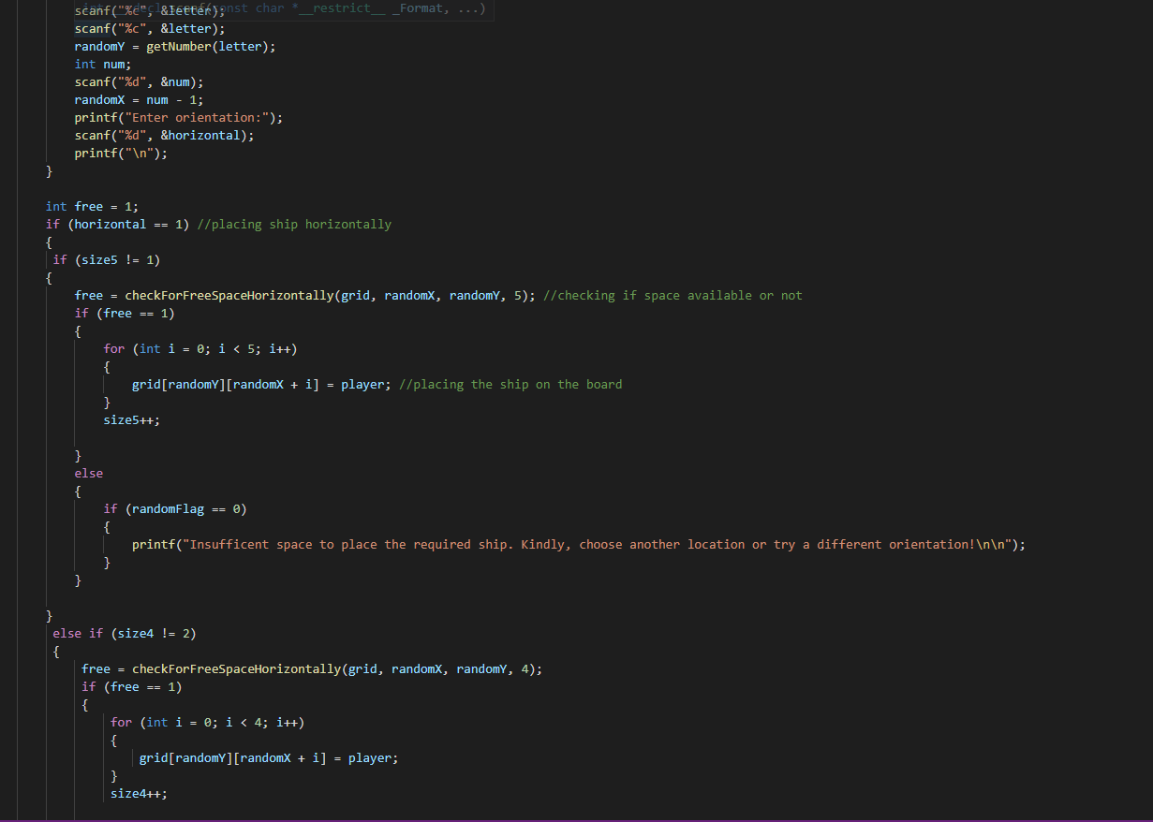
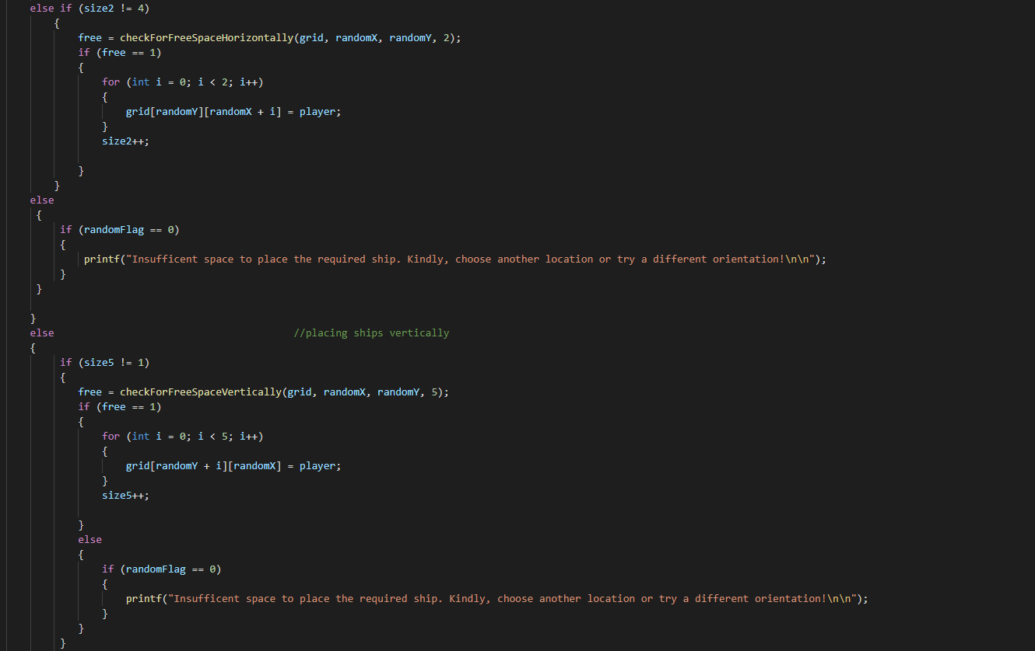
Continuation of PrintShip function

Slide 5
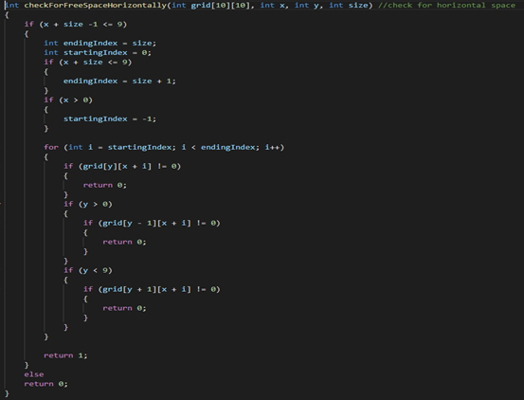
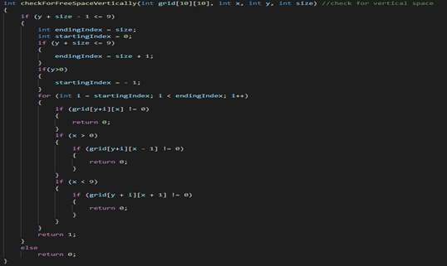
CheckForFreeSpace functions

Slide 6
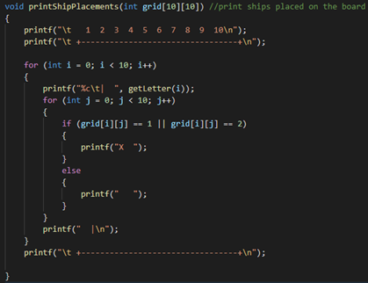
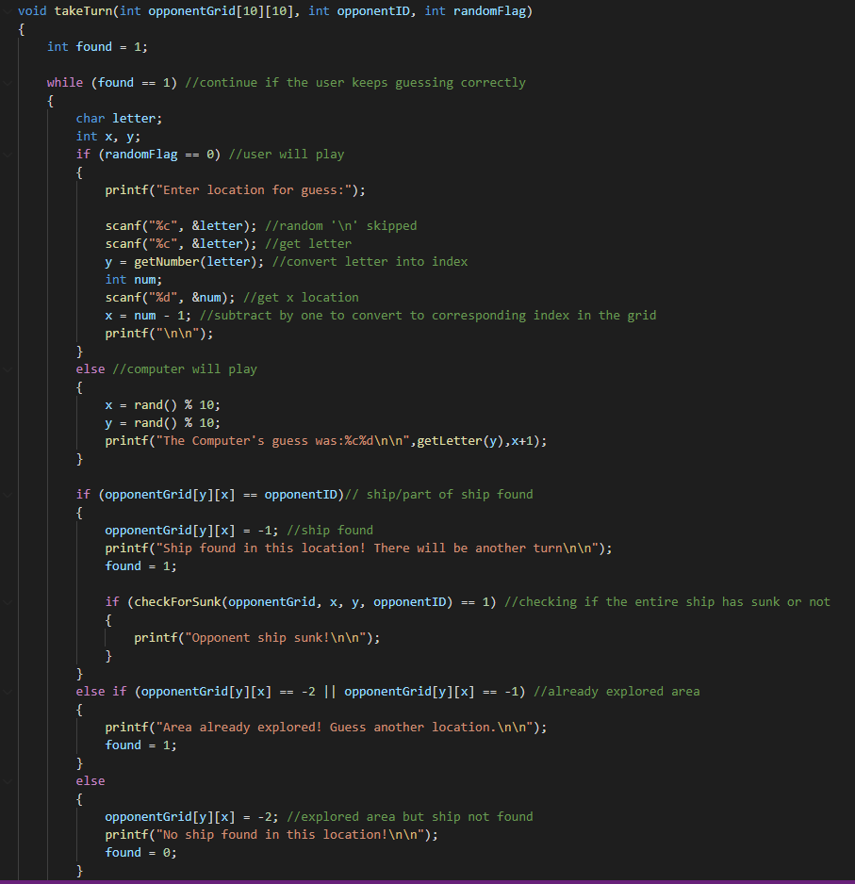
TakeTurn function

Slide 7
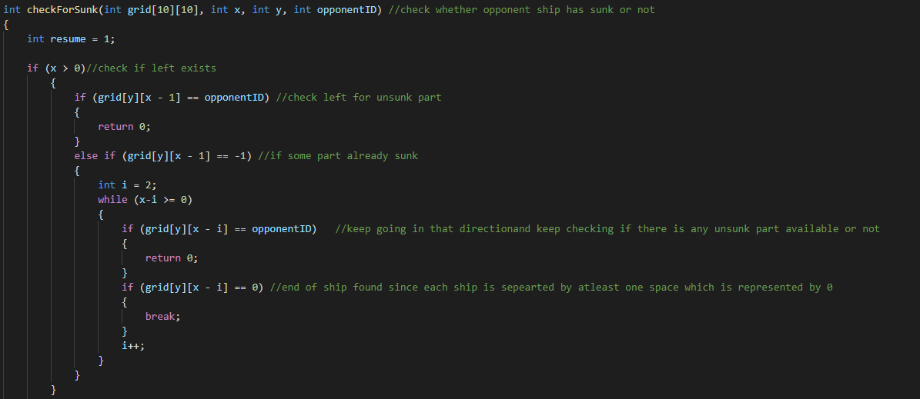
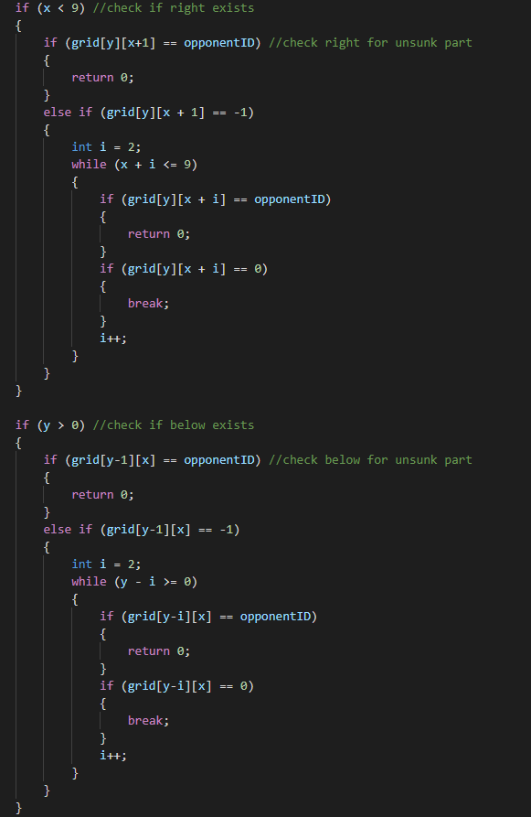
CheckForSunk function

Slide 8
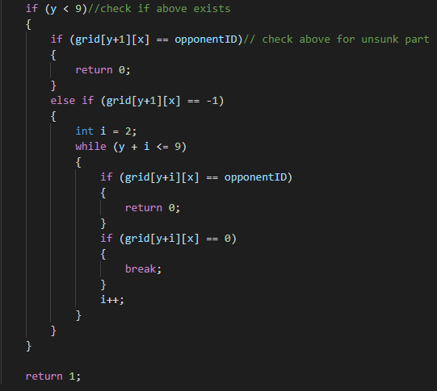
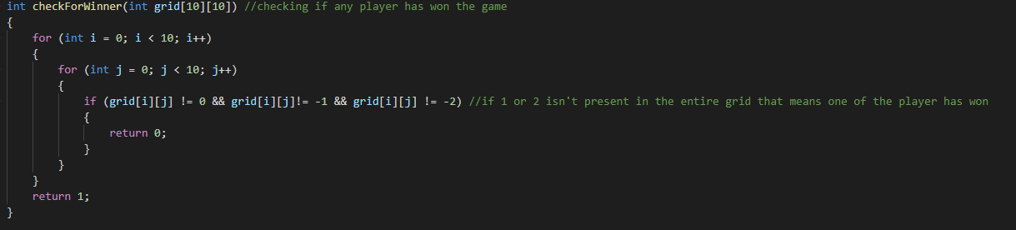
CheckForWinner function

Slide 9
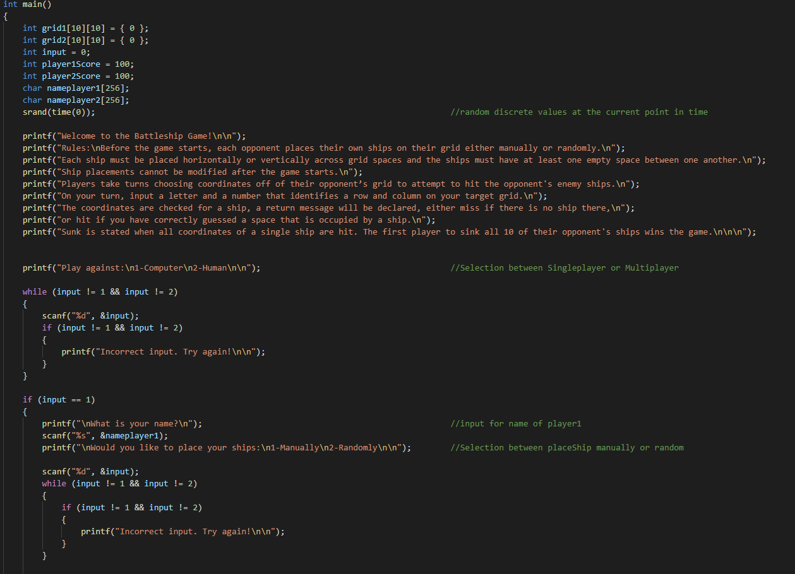
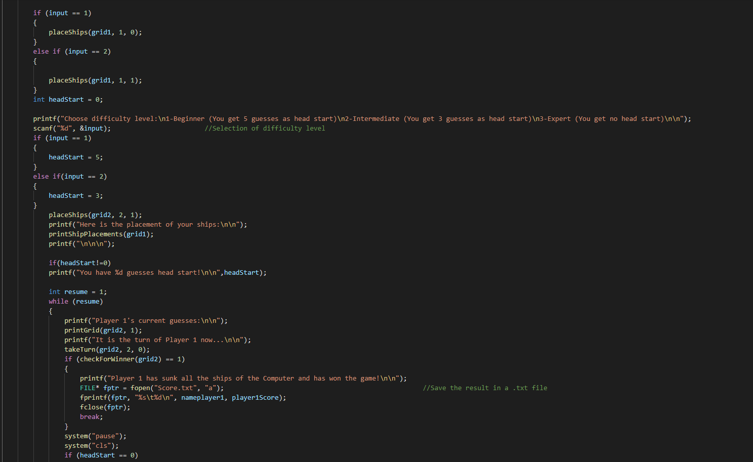
Main function

Slide 10
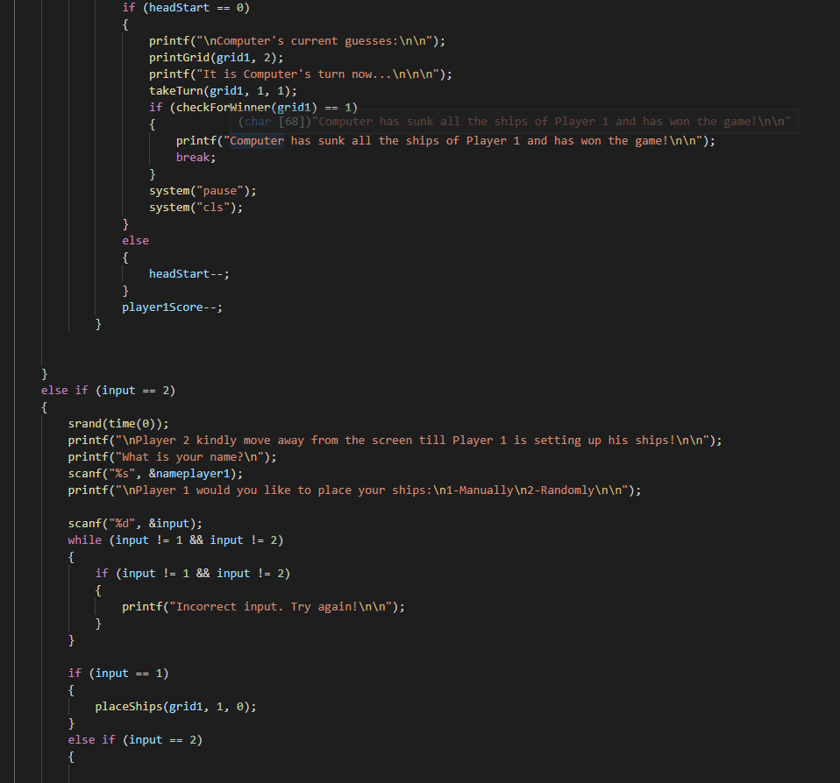
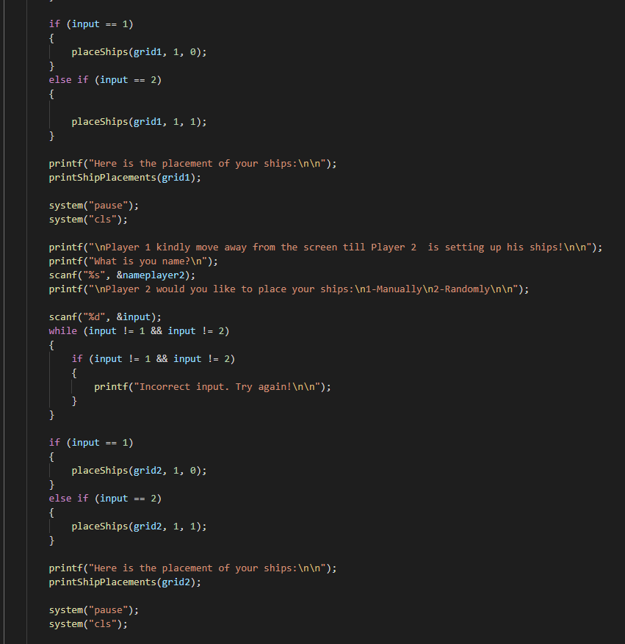
Main function(cont.)

Slide 11
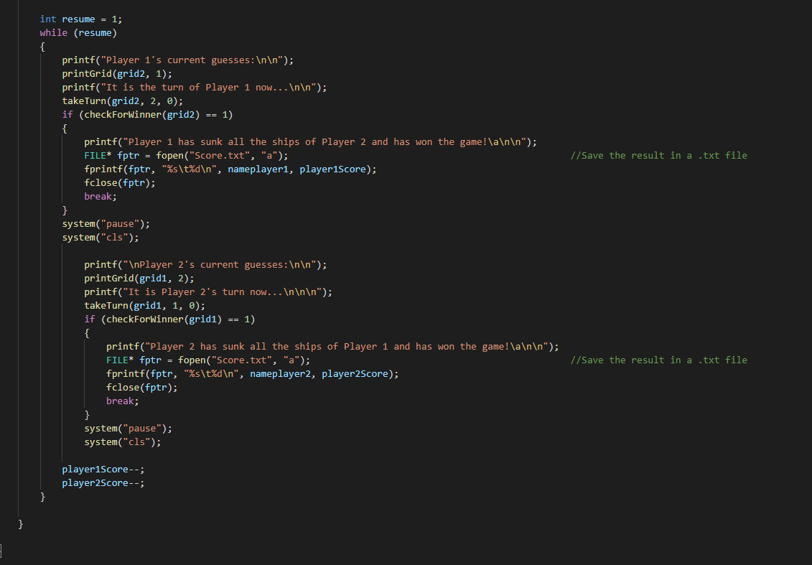
Main function(cont.)

Slide 12
THANK YOU FOR LISTENING

